Slide 1
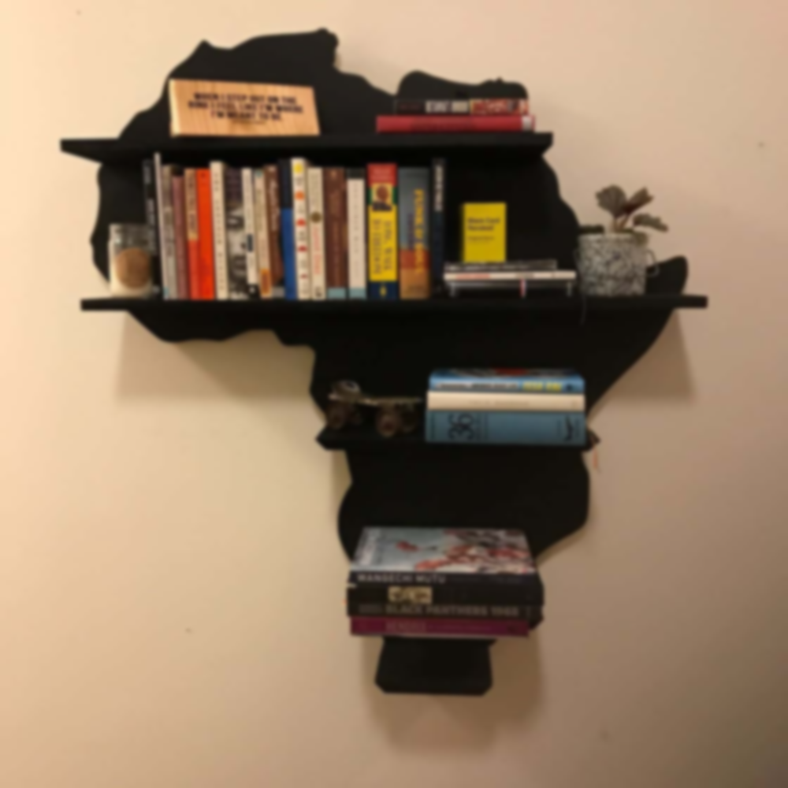
WELCOME TO OUR LIBRARY WEBSITE PRESENTATION
MADE BY:
ABDUL IDRISS
COORDINATOR:
MR NJIFANDA ERIC
MR MUA WALLACE

Slide 2
STEPS
INTRODUCTION
WOKDONE
DEMO
CHALLENGES ENCOUNTERED
CONCLUSION
REMARKS
QUESTIONS
1
2
3
4
5
6
7

Slide 3
WOKDONE
1
2
3
Angular
Which is a FrontEnd framework which uses Typescript
GOOGLE FONTS
Which is a site where you
Have the possibility to have different fonts
Coolors.co
Which is a website which you can use for different colour palettes
4
Fontawesome
Which is a website in which you have access and to different logos

Slide 4

3
5

Slide 5

CHALLENGE ENCOUNTERED
1
2
Designing the site
Debugging (fixing the code crash )
3
Logic when writing
the code

Slide 6
Conclusion and Remarks I encountered many challenges, it was interesting and instructive It was also amusing,fun and most of the time frustrating Better features are still to come with the future work Thanks to our Coordinator Mr NJIFANDA ERIC who guided us along this level

Slide 7
QUESTIONS ?

